Slide 1

Storytelling with Data
Kristyna Hughes

Slide 2

About Me ~ Kristyna Hughes
Senior data & analytics consultant at 3Cloud
Partners with Enertia to provide Power BI training
Worked with Power BI since 2018
My experience includes implementing and managing enterprise-level Power BI instances, training teams on reporting best practices, learning new coding languages to hack into Power BI, and building templates for scalable analytics.
Check out my blog: https://dataonwheels.wordpress.com/
Connect on LinkedIn: https://www.linkedin.com/in/kristyna-hughes-dataonwheels/

Slide 3

Trends in Data Spending
In 2015, companies spent an average of $7.4M on data-driven initiatives.
In 2022, that number is up to $12.3M with 55% of executives estimating that budget will increase.
That 40% increase in budget highlights a clear priority on cultivating a data-driven culture
88% of IT decision-makers believe collecting and analyzing data can fundamentally change their organization within 1-3 years.

Slide 4
The Knowledge Gap
“Lack of appropriate skill sets is a top challenge that IT decision-makers experience when making progress on their data strategies”
– Foundry 2022

Slide 5

Covering the Gap
Notes:
To turn our millions of dollars worth of data into actionable insights, we need to tell a story with it. Why a story? Storytelling has been and is a vital way humans understand and share the world around them. If numbers were as interesting and memorable as stories, our classic works of art would be the Pythagorean theorem instead of the Iliad and Odyssey.

Slide 6
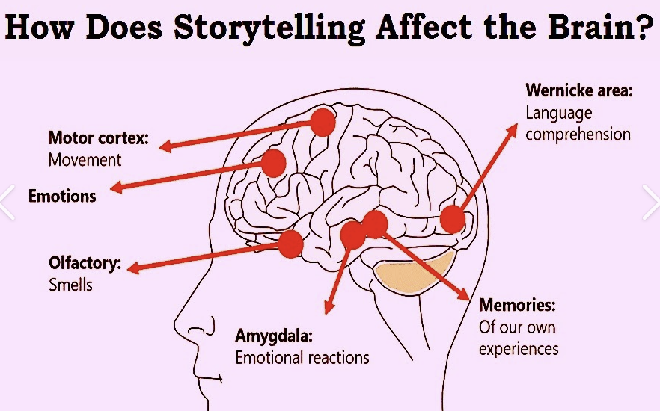
Storytelling – Engaging our Brains
Wernicke’s area (language)
Amygdala (emotions)
Minor neurons (empathizing)
Hippocampus (short-term memory storage)
Notes:
Listening to a story engages multiple parts of the brain, which is why listening to your great aunt's story for hours is exhausting, but also why stories are more memorable. Here are the parts of the brain engaged when you hear a story:
Wernicke's area (language)
Amygdala (emotions)
Minor neurons (empathizing)

Slide 7

Impact on Memory
The hippocampus (short-term memory storage) is more likely to push stories into long-term memory than numbers because they engage multiple areas of your brain.
Notes:
The hippocampus (short-term memory storage) is more likely to push stories into long-term memory than numbers because they engage multiple areas of your brain. This is why so many math classes include word problems. Thankfully, visualizing your data doesn't need to be like a math test.

Slide 8
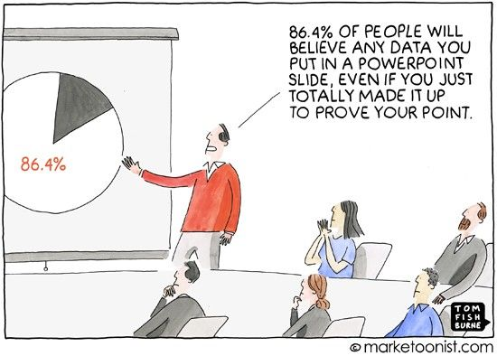
Elements of Storytelling with Data
Data
Visualizations
Story
Notes:
Data powers the visualizations that can communicate your story clearly and memorably. Similar to a picture book, a good report will quickly communicate a story and a great report will help you change that story through actionable insights. So how do we go from numbers to a story? From math class to lit? Through connecting visuals and numbers to elements of a story. Every story contains a few common elements: characters, setting, conflict, and resolution.

Slide 9

Taking a Page from Lit Class
Stories contain a few common elements:
Characters
Setting
Conflict
Resolution
Notes:
For example, imagine you have seen a downward trend in sales from Texas for smart cars. The characters would be your previous and current customers in Texas, setting is the timeline of the downward trend and the customers across the country, conflict may be that news stations in Texas ran a story about hackers getting into smart cars, and resolution may be to advertise a security patch through local news stations in Texas. There may not be a conflict in your story (maybe you're exceeding your goals), so that section can be skipped in favor of focusing on what is going well.

Slide 10

Building a Data-Driven Culture
Trust in data, visuals, and storytellers is key
Start small
Look for patterns in your daily life
Tie every decision back to data
Notes:
Thankfully, this approach does not need to be all or nothing. It can be as simple as looking for patterns in your personal life like spending more money on ice cream deliveries after watching sad movies. A simple cost-saving would be to stock up on ice cream in advance and avoid the delivery fees. Finding a new innovation source may look like watching romantic comedies instead of sad movies or switching to popcorn which is much more cost effective.

Slide 11
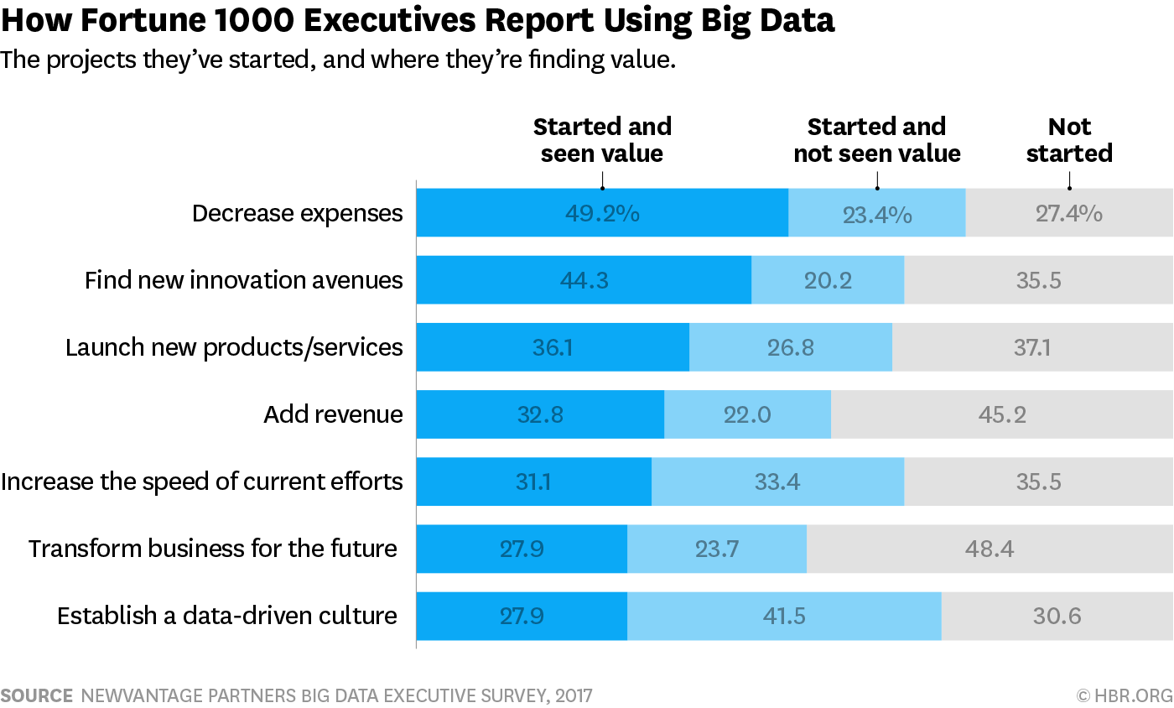
Getting the ROI on Data
Harvard Business Review
Notes:
According to a study by Harvard Business Review, Fortune 1000 executives have seen the most value by aiming to decrease expenses. The second highest is by finding new innovation avenues. Decreasing expenses is great, it allows your company to lower overhead costs of operation and increase profit margin. However, there is only so much overhead you can eliminate which is why finding new innovation avenues will be the long term ROI from using big data.

Slide 12

Demo Time!

Slide 13

Questions?

Slide 14
Additional Resources
https://online.hbs.edu/blog/post/data-storytelling
https://hbr.org/2013/04/how-to-tell-a-story-with-data
https://www.northeastern.edu/graduate/blog/blog-how-to-tell-stories-with-data/
https://www.datavis.ca/gallery/lie-factor.php
https://webtribunal.net/blog/cloud-computing-statistics/
https://www.intersystems.com/data-excellence-blog/whos-spending-money-on-big-data/
https://foundryco.com/tools-for-marketers/research-data-and-analytics/
https://hbr.org/2017/04/how-companies-say-theyre-using-big-data
https://online.hbs.edu/blog/post/data-driven-decision-making
https://www.pwc.com/us/en/services/consulting/cloud-digital/data-analytics.html

Slide 15
Don’t forget to connect, thanks for listening!
Connect on LinkedIn: https://www.linkedin.com/in/kristyna-hughes-dataonwheels/
Check out my blog: https://dataonwheels.wordpress.com/
Email me at: Kristyna@dataonwheels.com

